Slide 1
The Drumming Robot
Michael Engstrom
~
ECE 579 – Winter 2013

Slide 2
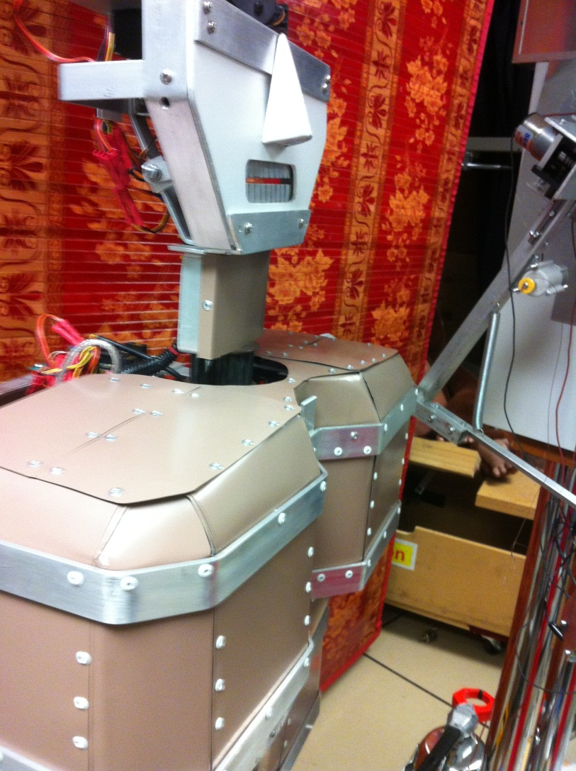
Adding to ‘DIM’ Robot

Slide 3
Project Idea
Design a robot that will play drums in rhythm to an audio source which is detected in the environment
A robot control board will move servos to make arms and legs pound drums to a beat
An input device will detect the audio, extract the beat, and send the information to the robot controller

Slide 4
Project Phases
Mechanical design of robot
Arms and legs to beat drums
Interface to control software
Software
Input of audio source
Beat detection
Output to robot controller

Slide 5
Mechanical Design
Add limbs to the DIM robot (as seen in the Robot Theater window)
Use servos to move limbs
A Pololu ‘Orangutan SVP’ robot controller will handle the servo movement

Slide 6
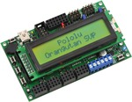
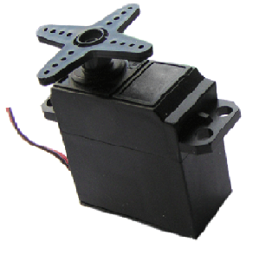
The Pololu Orangutan SVP Servo Controller

Slide 7
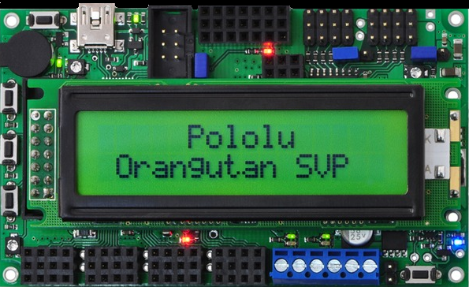
Orangutan SVP from Pololu

Slide 8
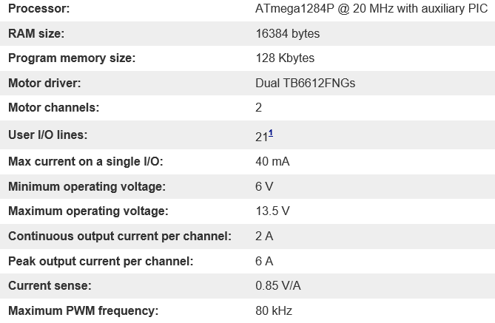
Orangutan Specifications

Slide 9
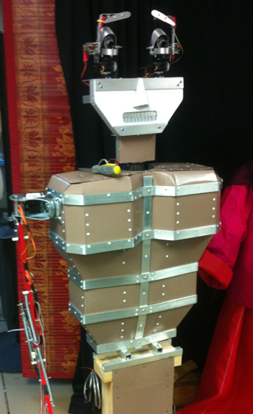
DIM’s Torso and Arm

Slide 10
Software Design
Beat Detection Algorithm
Rice University Project
Based on an MIT design
Uses MATLAB to extract beat information from audio input
Serial interface to Orangutan board
BPM and control information

Slide 11
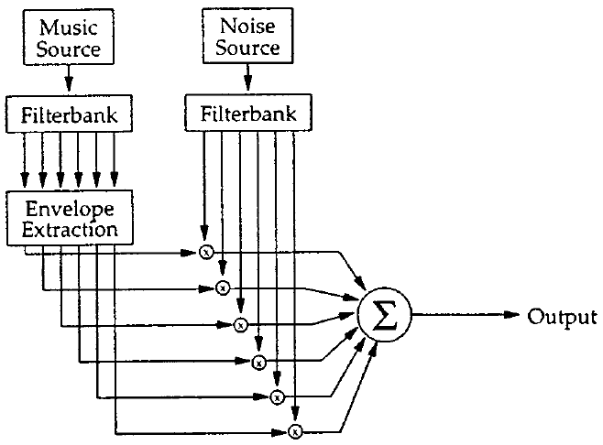
Beat Detection

Slide 12
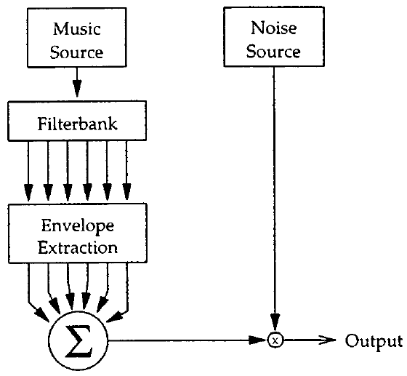
PSYCHOACOUSTIC SIMPLIFICATION
Simplification of Noise sources

Slide 13
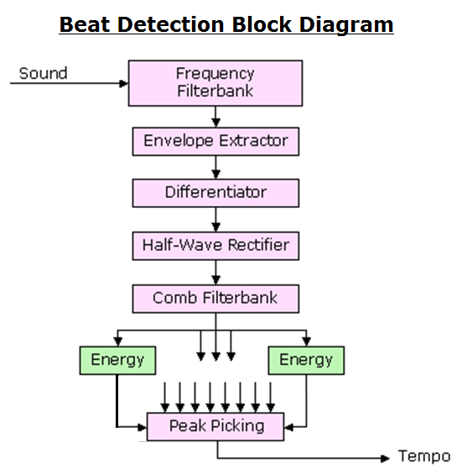

Slide 14
Beat Detection Algorithm
Step 1 – Frequency Filterbank
Split audio file into several frequency ranges
Similar instrument ranges can inhibit the detection of the beat
Allows for different instruments to be detected
0-200Hz, 200-400Hz, 400-800Hz, 800-1600Hz, 1600-3200Hz

Slide 15
Beat Detection Algorithm
Step 1 – Frequency Filterbank
Each filter is implemented using a sixth-order elliptic filter
3 dB of ripple in the passband
40 dB of rejection in the stopband.

Slide 16
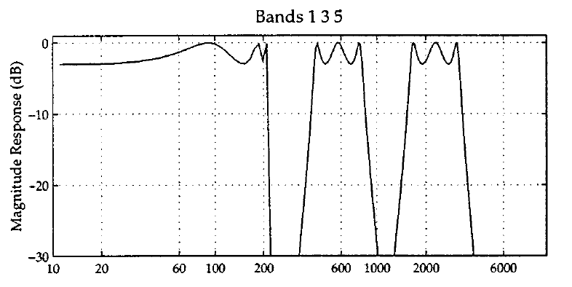
Beat Detection Algorithm
Step 1 – Frequency Filterbank

Slide 17
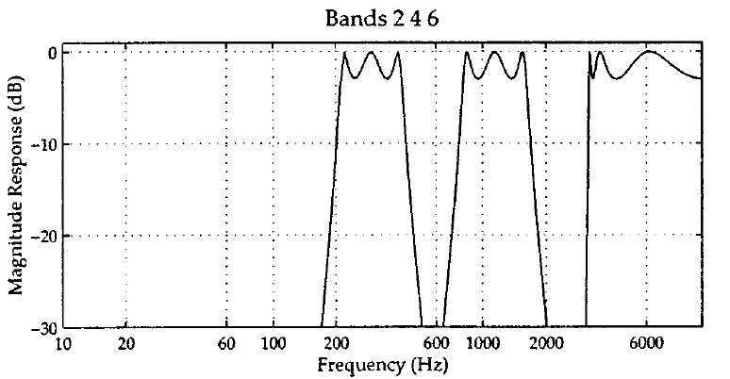
Beat Detection Algorithm
Step 1 – Frequency Filterbank

Slide 18
Beat Detection Algorithm
Step 2 – Envelope Smoothing
Low-Pass Filter each of the signal segments
Convert to Frequency Domain
Convolve and transform signal
Allows for detection of sudden changes in audio content

Slide 19
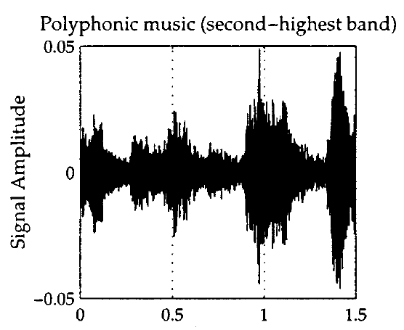
Beat Detection Algorithm
Step 2 – Envelope Smoothing: Example

Slide 20
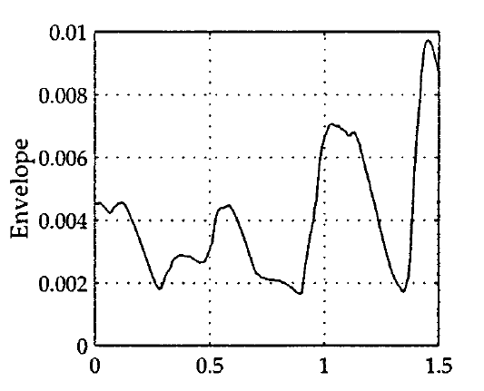
Beat Detection Algorithm
Step 2 – Envelope Smoothing: Example

Slide 21
Beat Detection Algorithm
Step 3 – Differentiate signal
Accentuate when the sound changes
Corresponds to beats
Step 4 – Rectify signal
Only see changes in sound
Signals ready to be analyzed

Slide 22
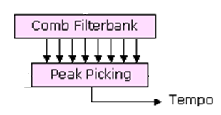
Beat Detection Algorithm
Step 5 – Comb Filter
Use various filters
Determine which has highest energy
Maximum value is the fundamental tempo

Slide 23


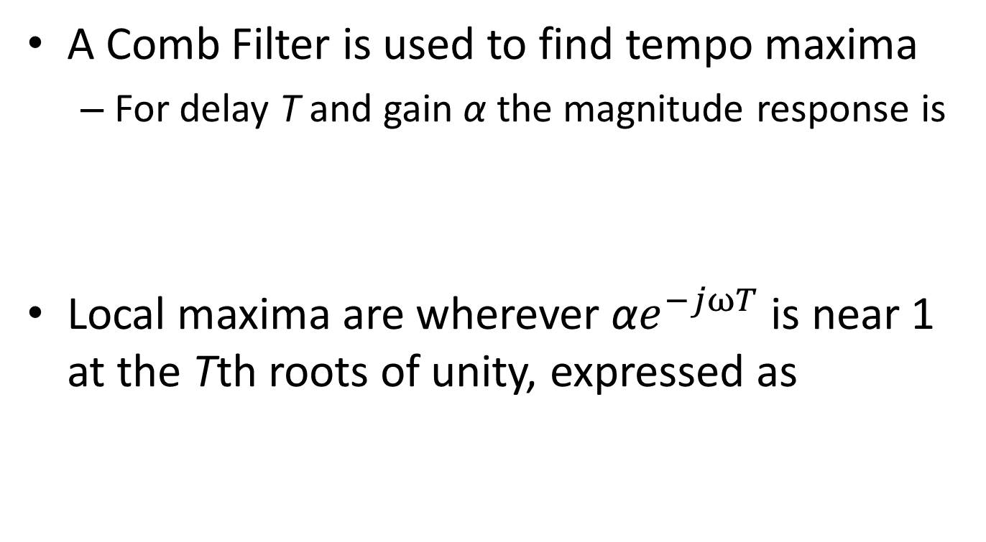
Beat Detection Algorithm
A Comb Filter is used to find tempo maxima
For delay T and gain α the magnitude response is
Local maxima are wherever ${\text{α}e}^{−jωT}$ is near 1 at the Tth roots of unity, expressed as

Slide 24
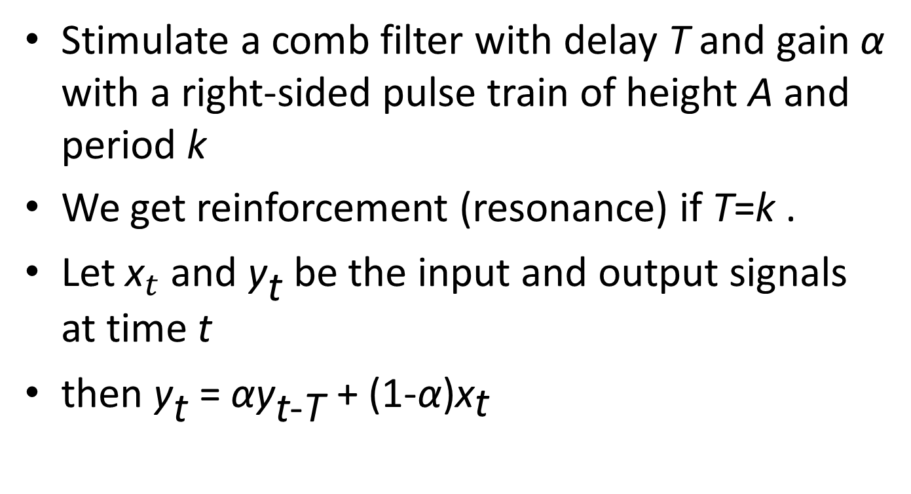
Beat Detection Algorithm
Stimulate a comb filter with delay T and gain α with a right-sided pulse train of height A and period k
We get reinforcement (resonance) if T=k .
Let ${\text{x}}_{t}$and ${\text{y}}_{\text{t}}$ be the input and output signals at time t
then ${\text{y}}_{\text{t}}$ = ${\text{α}\text{y}}_{\text{t}\text{−}\text{T}}$ + (1-α)${\text{x}}_{\text{t}}$

Slide 25
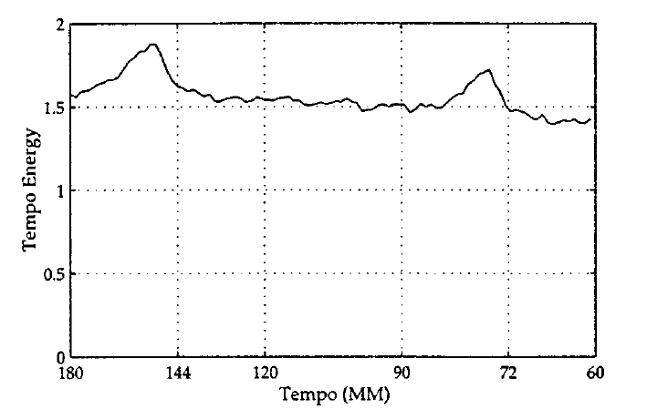
Beat Detection Algorithm
Energy is higher at dominant tempos

Slide 26
Implementing in MATLAB
Input audio from .wav file or microphone
Extract BPM information
Algorithm described previously
Send data to Orangutan robot controller
Serial interface between host and controller
Change speed and tempo of robot drumming arms according to inputs

Slide 27
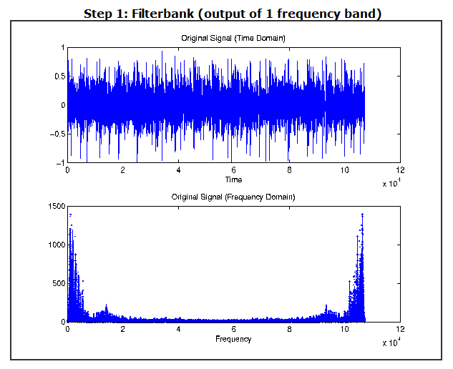
MATLAB Plots

Slide 28
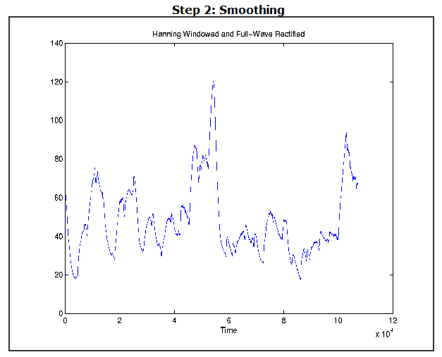
Smoothing Plot

Slide 29
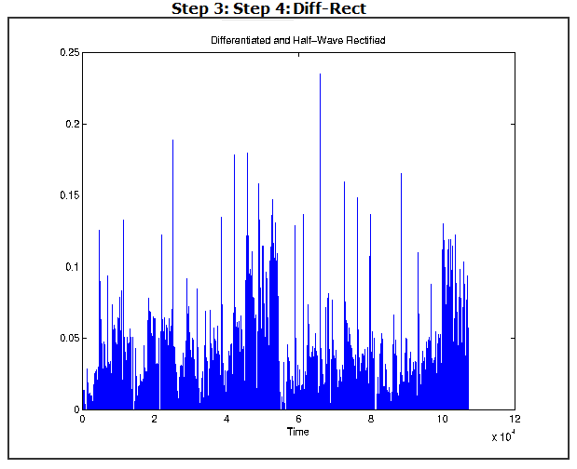
Differentiate and Rectify

Slide 30
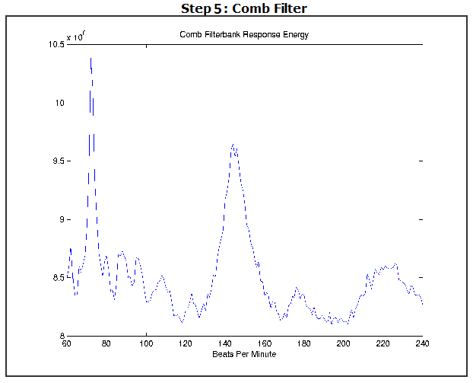
Comb Filter

Slide 31
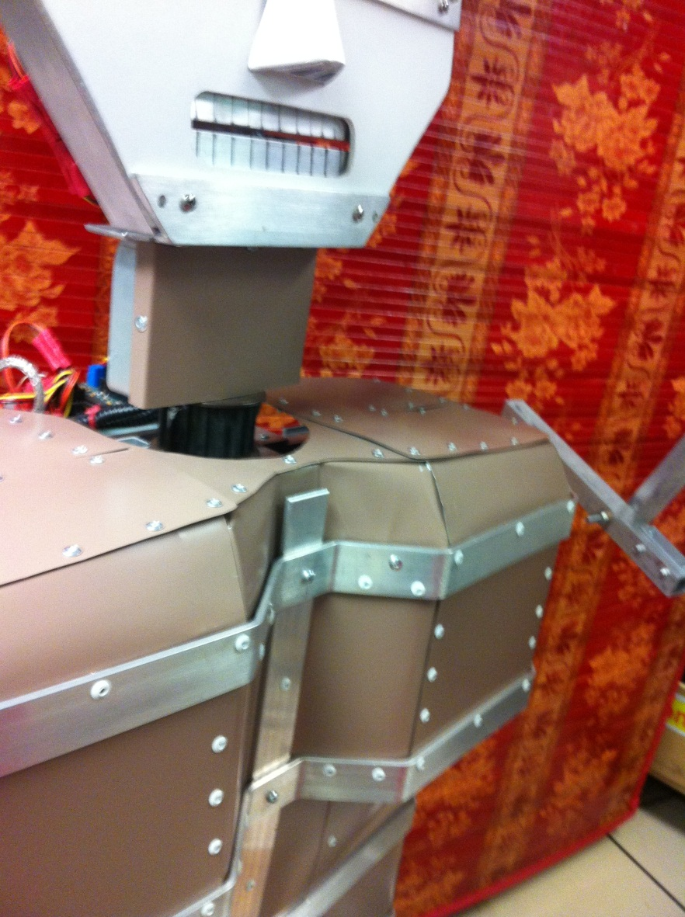
The Drumming Robot

Slide 32
References
Balanço: The Contour of Relative Offbeatness
Mehmet Vurkaç - 2012
Beat Sync Project – Rice University 2001
http://www.clear.rice.edu/elec301/Projects01/beat_sync/
Pololu Robotics and Electronics
http://www.pololu.com

